Slide 1
Safeguarding democracy
Chapter 1

Slide 2
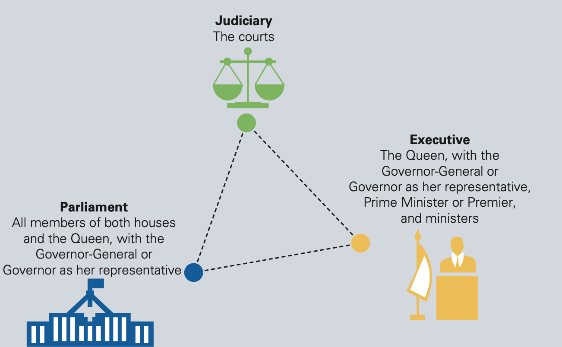
1.3 Australia’s democracy and how it compares to governments in Asia
Australia is a representative democracy which means parliament is given power through elections to act on behalf of citizens
Two of the fundamental considerations that make up Australian democracy are:
Rule of law - the law is supreme and applied equally to all
The separation of powers - our political system is separated into branches which balance and provide checks on each other
The separation of powers as it operates in Australia

Slide 3
1.3 Australia’s democracy and how it compares to governments in Asia
Democratic ideals and features of Australian representative democracy
A modern democracy allows and provides the means of open political participation
People are able to contribute to the political system by voting, forming political parties and organisations, and assembling and protesting peacefully
Free and fair elections are held regularly
House of Representatives: lower house of Parliament which represents the majority of citizen votes
Courts: independent from influence by the legislative and executive branches
Basic rights are protected through the Constitution, legislation or parliamentary statutes, international agreements, conventions and court resolutions

Slide 4
1.3 Australia’s democracy and how it compares to governments in Asia
Comparing Australia’s system of government to its neighbours
The constitutional monarchies: the monarch is head of state but limited in their power and authority through a constitution
E.g. Thailand, Japan
The republics: The head of state (the President) is elected by the people, as well as the legislative body
E.g. India, Indonesia
The communist republics: Single-party state where the people’s rights and freedoms are strictly controlled
E.g. People’s Republic of China, Democratic People’s Republic of North Korea

Slide 5
1.4 Threats to Australia’s democracy
Challenges to sustaining a resilient democracy
Challenges faced by Australian democracy include:
Divisions in the community and a rise in populist politics centred on identity
The threat of terrorism
The increasing digitalisation of the media
Distrust of politicians and indifference of voters
Populism and the rise of identity politics: populism refers to the view that society is comprised of two groups: the people and an elite
Create an 'us' versus 'them' mentality
Associated with far-right and conservative groups

Slide 6
1.4 Threats to Australia’s democracy
Terrorism: intentional use of violence to further political or religious goals
Usually directed towards civilians and aims to produce a state of fear
Digitisation of media: social media has allowed people to become more easily engaged in politics
But has also increased the risk of misinformation, raising questions about the reliability of sources of political information, and enabling platforms for divisive and extreme views
Distrust and indifference: contributes to the rising number of people who identify with ‘outsider’ parties
Disillusioned voters may disengage from the democratic process completely

Slide 7
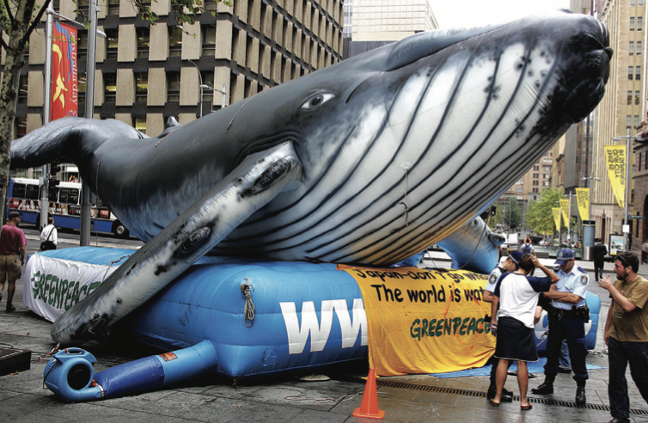
1.5 Safeguarding Australia’s democracy
Democracy can be fragile when its principles and institutions are not protected
The greatest safeguard to democracy is the people who must be able to take part in civic, social and economic life
Rights and freedoms (civil liberties) – association, assembly and expression: allows individuals with similar beliefs to organise as groups e.g. political parties, interest groups
Interest groups attempt to influence governments via demonstrations, petitions or lobbying
Greenpeace activists in Sydney protesting against Japanese whaling in the Southern Ocean

Slide 8
1.5 Safeguarding Australia’s democracy
People power – Russia and Belarus: in a democracy, freedom of expression lets individuals present any ideas that do not infringe on the rights of others
In authoritarian systems, the government reacts in a violent and repressive way towards protests and demonstrations
Protests in Belarus in 2020 and in Russia in 2021 were both met with violence
Free media: a free press is a symbol of a free people
The media provides people with diverse perspectives from many sources allowing them to critically analyse information
People can also easily obtain information which is often shared without thinking

Slide 9

1.5 Safeguarding Australia’s democracy
Your right to know or a criminal action? The case of Annika Smethurst and the ABC
Two news reports in 2017 and 2018 caused the Australian Federal Police (AFP) to conduct raids on the ABC and at reporter Annika Smethurst’s private residence
In response, newspapers organised a front page blackout demanding wider protections and freedoms for journalists and their sources
Front covers of Australian newspapers that have been blacked out to protest the Australian Government action

Slide 10
1.5 Safeguarding Australia’s democracy
Strong institutions founded on democratic values – limiting corruption by limiting the power of government: limited government is a concept essential to a democracy, as it constrains a government’s influence over the decisions and lives of its people
This can be achieved through constitutionalism that incorporates checks and balances between the branches of government, and bicameralism
The Australian Constitution – the rulebook for government in Australia
Bicameralism – Australia has both a House of Representatives and a Senate chamber, and both houses must pass a bill before it becomes law
Independent judiciary – third branch of government and one of the more significant checks and balances

Slide 11
1.6 Australia’s roles and responsibilities at a global level
Australia’s participation in the world
Australia participates in the global community in many ways:
Cooperation with other countries through international organisations such as the United Nations (UN)
Support of peaceful resolutions to conflict by providing peacekeeping forces
Foreign aid to developing countries
Support of NGOs (non-government organisations), whose aims include health, education and economic development
Peacekeeping: the UN deploys peacekeepers to resolve conflict, maintain ceasefires and help areas transition to peace
Australia has participated in more than 50 UN peace and security missions

Slide 12
1.7 Australia’s international agreements and obligations
Australia’s participation in the world
Australia as a global citizen not only participates in the global community but is internally affected by it
International treaties and conventions: the main form of international law
International organisations (such as the United Nations) negotiate treaties
Signing a treaty means a country supports a treaty’s intention
Ratifying a treaty means a country agrees to incorporate the treaty into their own laws
Treaties can cause conflict in Australia, when governments attempt to pass laws that enforce the treaties or noticeably fail to uphold them

Slide 13
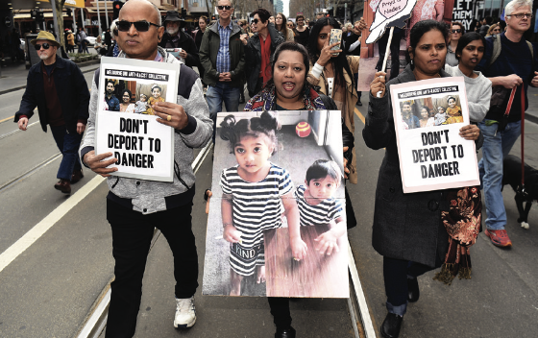
1.7 Australia’s international agreements and obligations
The Refugee Convention of 1951
After World War II, the Refugee Convention was developed
It outlines the rights of refugees and asylum seekers, and the responsibilities of countries towards them
Over the past few years, the issue of the Murugappanand family, has raised questions of Australia’s obligations under international law and human rights principles to assist others
Protesters in Melbourne in 2019 marching in support of the Murugappanand family

Slide 14
1.7 Australia’s international agreements and obligations
Enforcing international law
Once a country has signed a commitment to the global community, there needs to be methods to ensure it lives up to them
Within Australia, two ways are the Human Rights Commission (HRC) and the Joint Parliamentary Committee on Human Rights
The UN also has a judicial branch known as the International Court of Justice (ICJ) to resolve disputes between nations, using international laws and conventions
In 2010, Australia brought Japan to the ICJ while, in 2014, Timor-Leste took Australia to the ICJ

Slide 15
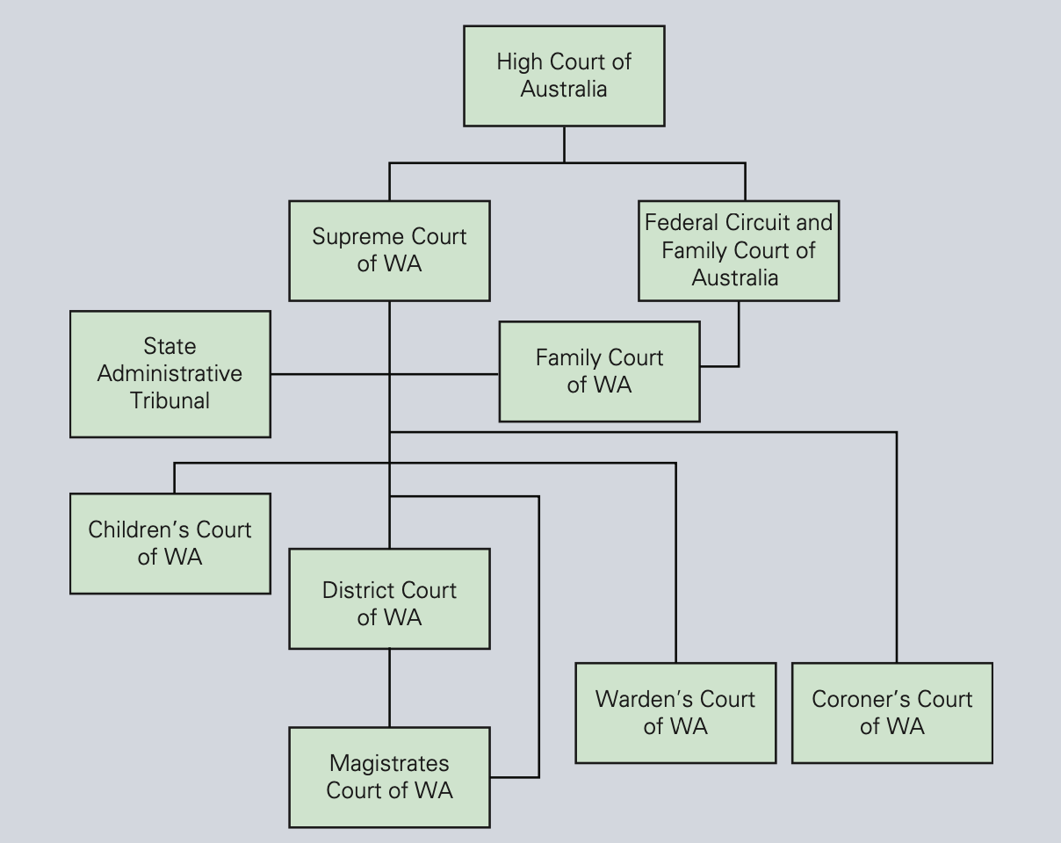
1.8 The role of the High Court
The High Court was established by the Constitution
It is the only court which can hear cases regarding constitutional law and interpretation and has appellate jurisdiction in cases from appeal courts
The full bench of the High Court of Australia is made up of seven judges
The Australian court hierarchy

Slide 16

1.8 The role of the High Court
The role of the High Court in protecting the Westminster system: in 2017, the High Court was asked to interpret Section 44 of the Constitution which outlines the causes for disqualification as a representative in parliament
The role of the High Court in protecting democratic values
Rule of law and separation of powers: in 1951, the High Court ruled against the government of the day
It demonstrated the checks and balances that the High Court carries out under the separation of powers
Democracy and participation: in 2006, the High Court was asked to rule on whether an amendment to the Commonwealth Electoral Act 1918 was constitutional.

Slide 17
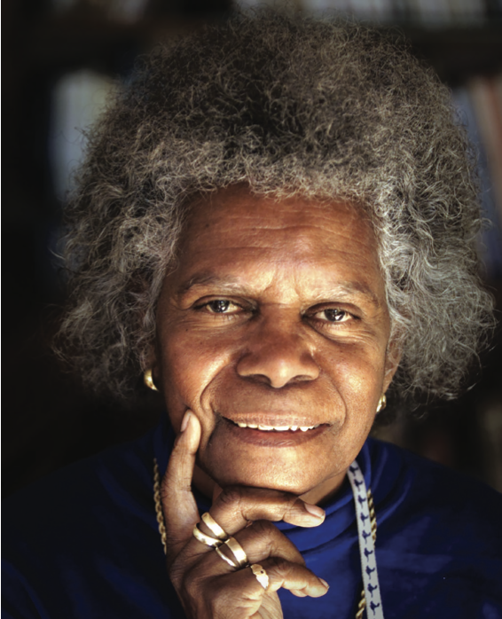
1.8 The role of the High Court
Rights and responsibilities: one of the most significant High Court decisions involving rights was the 1992 Mabo decision
It found that Aboriginal people had the right to native title, a system of ownership over their traditional lands
The role of the High Court in upholding international laws: by checking other branches, the High Court can ensure Australia’s international commitments to the rights of groups and individuals
E.g. the 2010 Malaysia Solution
Bonita Mabo's husband Eddie was the lead plaintiff in the Mabo case

Slide 18
1.9 Conclusion: why does it matter?
To develop, maintain and sustain an effective democratic society is hard work
The process of building a successful democracy does not happen overnight
It has never been static; democracy grows and changes, ebbs and flows
The advent of social media has given all citizens the ability to discuss ideas, mobilise and be agents of social change, a safeguard to democracy
However, it can also produce misinformation and breed hate groups that aim to infringe the rights of others
By educating ourselves about what makes a good democracy, how we are a part of that process and analysing how democracies can fail, we are better prepared to ensure that the democracy we have in Australia is not only protected, but benefits all of us who live here.

